Slide 1
PROJECT TITLE
FLIGHT PRICE PREDICTION
BY – RANJEET JANAGOUDA

Slide 2
Problem Statement
Anyone who has booked a flight ticket knows how unexpectedly the prices vary. The cheapest available ticket on a given flight gets more and less expensive over time. This usually happens as an attempt to maximize revenue based on -
1. Time of purchase patterns (making sure last-minute purchases are expensive)
2. Keeping the flight as full as they want it (raising prices on a flight which is filling up in order to reduce sales and hold back inventory for those expensive last-minute expensive purchases)
So, you have to work on a project where you collect data of flight fares with other features and work to make a model to predict fares of flights.

Slide 3
Steps Involved
_{1. Data Collection}
You have to scrape at least 1500 rows of data. You can scrape more data as well, it’s up to you, More the data better the model
In this section you have to scrape the data of flights from different websites (yatra.com, skyscanner.com, official websites of airlines, etc). The number of columns for data doesn’t have limit, it’s up to you and your creativity. Generally, these columns are airline name, date of journey, source, destination, route, departure time, arrival time, duration, total stops and the target variable price. You can make changes to it, you can add or you can remove some columns, it completely depends on the website from which you are fetching the data.
_{2. Data Analysis}
After cleaning the data, you have to do some analysis on the data. Do airfares change frequently? Do they move in small increments or in large jumps? Do they tend to go up or down over time?
What is the best time to buy so that the consumer can save the most by taking the least risk? Does price increase as we get near to departure date? Is Indigo cheaper than Jet Airways? Are morning flights expensive?
_{3. Model Building}
After collecting the data, you need to build a machine learning model. Before model building do all data pre-processing steps. Try different models with different hyper parameters and select the best model.
Follow the complete life cycle of data science. Include all the steps like
_{1. Data Cleaning}
_{2. Exploratory Data Analysis}
_{3. Data Pre-processing}
_{4. Model Building}
_{5. Model Evaluation}
_{6. Selecting the best model}

Slide 4
Our Exercise
Scrap the data like airline name, date of journey, source, destination, route, departure time, arrival time, duration, total stops and the target variable price. from any of the websites which deals in used cars selling. After doing all the data cleaning, EDA, data pre-processing then build a model to predict the price with different algorithms to find the best model.

Slide 5


Slide 6
Data Collection Phase
Using the selenium we can scrap the data from a flight searching website website. I am scraping the data from Kayak website for different routes like Delhi to Mumbai, Delhi to Bengaluru Mumbai to Pune etc. With the help of selenium we can scrap the data easily. We are scraping the information such as airline name, date of journey, source, destination, route, departure time, arrival time, duration, total stops and the target variable price After scrapping the data successfully make a DataFrame of that & save it as csv file for future use.

Slide 7
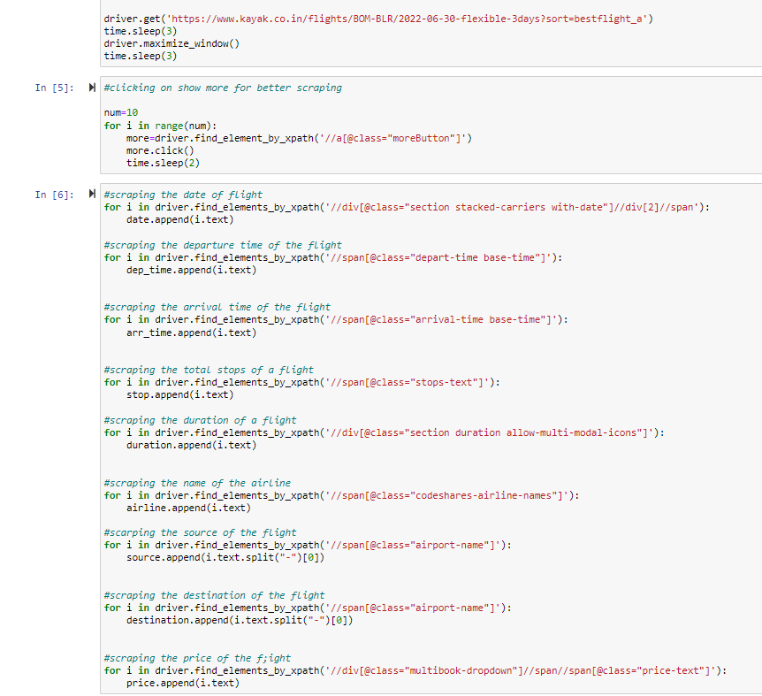
Let’s see the code for Data Scraping
Import selenium and webdriver to initiate the chrome.
Get the website using driver.get
Create blank list for the attributes you want to collect
Execute the code for scraping the data of each attribute for different locations
Make a DataFrame of extracted data and store it in a csv file

Slide 8
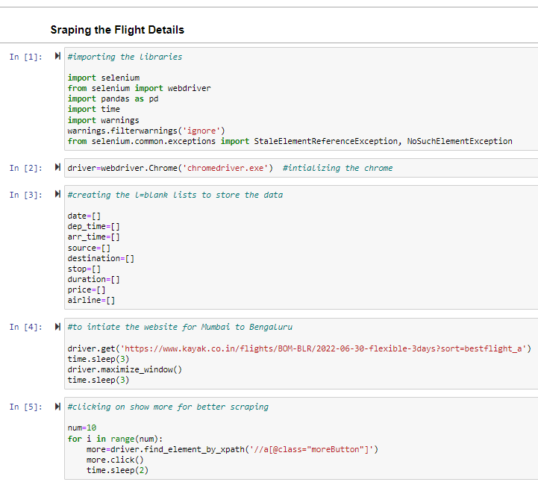
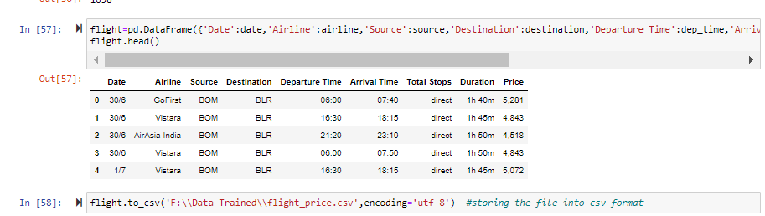
Let’s see the code for Data Scraping

Slide 9
Model Building Phase
Now, we have successfully scrap the data of around 1650 rows.
Let’s go ahead with the data cleaning and EDA process. As we have the continuous data in target we will go with the regression models to predict the price. Use the different regression model to find the best model for our prediction. Use the CV score and different hyper parameters to find the best model and check the errors in the model as well. Save the best model and check the actual & predicted values from your best model.

Slide 10
Steps Involved
Load the dataset
Distinguish the attributes
Checking the null values & handled them accordingly
Do the EDA
Check the correlation & removing the outliers
Feature Engineering – Find the best machine learning model to get the best accuracy.
Check the cross val score & perform the hypermeter tuning.
Save the model & check the predicted & actual values using the best saved model.

Slide 11
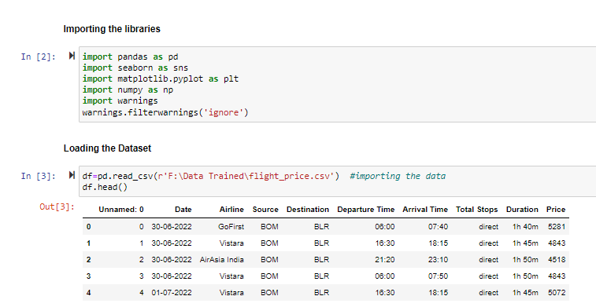
Load the dataset

Slide 12
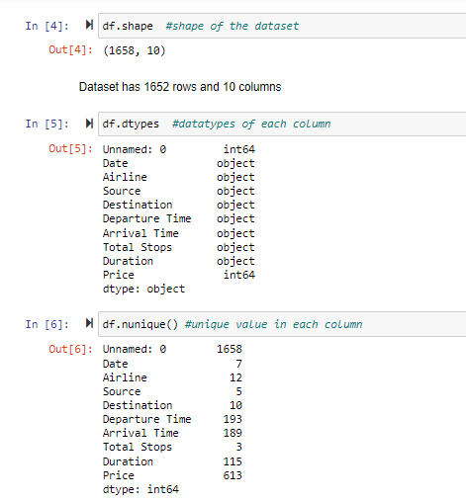
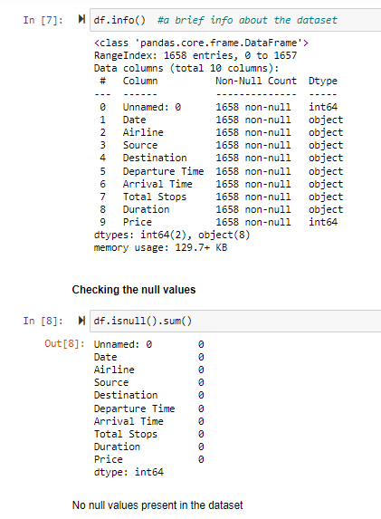
Checking the Attributes
First & last five rows the dataset
Shape of the dataset
Columns present in the dataset
Brief info about the dataset
Datatype of each column
Null values present in the dataset
Number of unique values present in each column

Slide 13
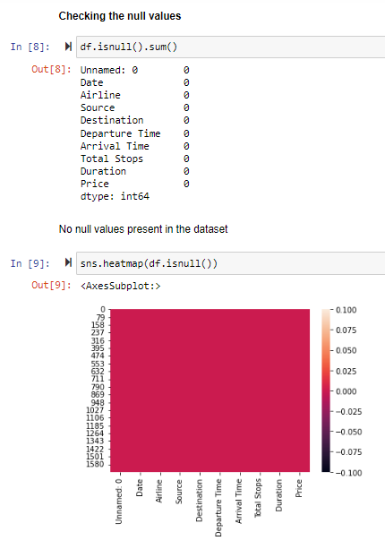
Null Values
Our dataset contain no null values so there is no need to handle them. We can go ahead to EDA & visualization part.

Slide 14

Exploratory Data Analysis

Slide 15
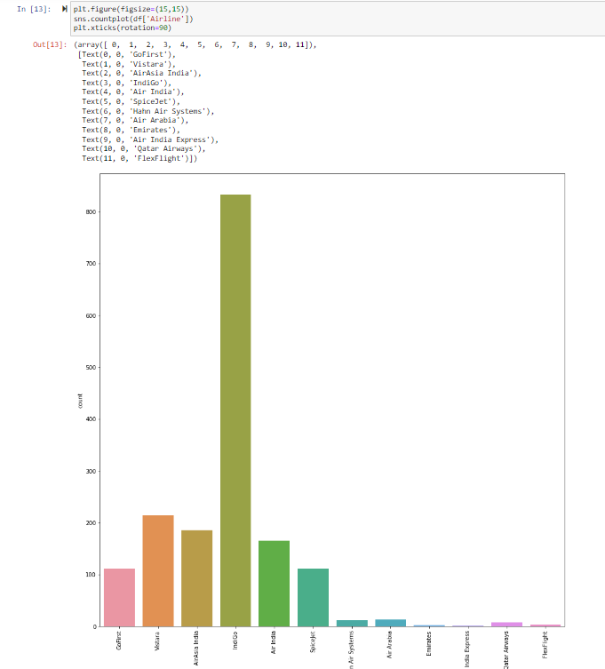
EDA
Univariate Analysis
Let’s understand the each variable one by one and try to interpret about them.
We have a very large number of fights of IndiGo airline
Contains more of the source of flight is Delhi
Favourite Destination is Bengaluru
Most of the flights are direct
We have the price index less than 20000 a very low ratio is towards the higher side

Slide 16
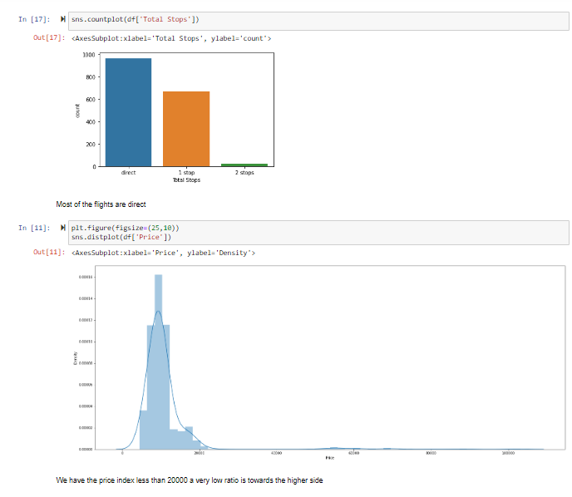
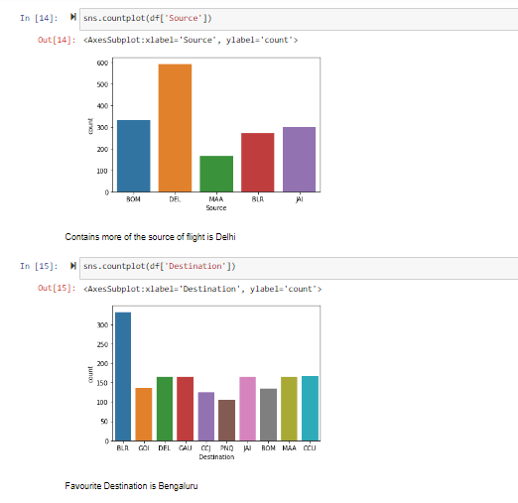

Slide 17
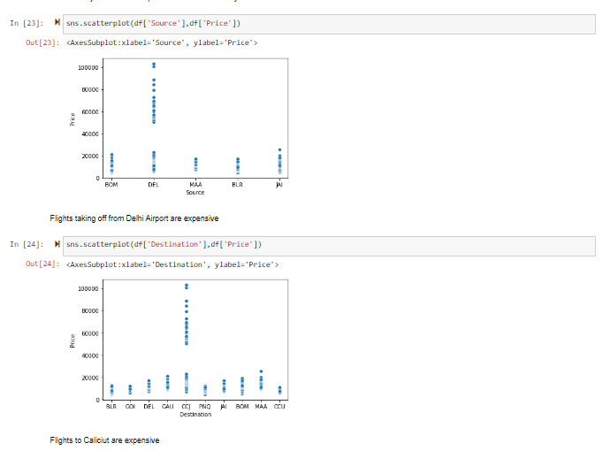
EDA
Bivariate Analysis
Let’s understand the each variable relation with the target variable and interpret how target variable vary with the inputs.
Prices will increase with the month when we move toward the departure date prices will go up
If we book near the departure date them price will be high and drastically tends to higher side
1 stop flights are expensive than others
Qatar airways is the most expensive airline followed by Air Arabia
Flights taking off from Delhi Airport are expensive
Flights to Calicut are expensive
Morning flights are expensive than night ones

Slide 18
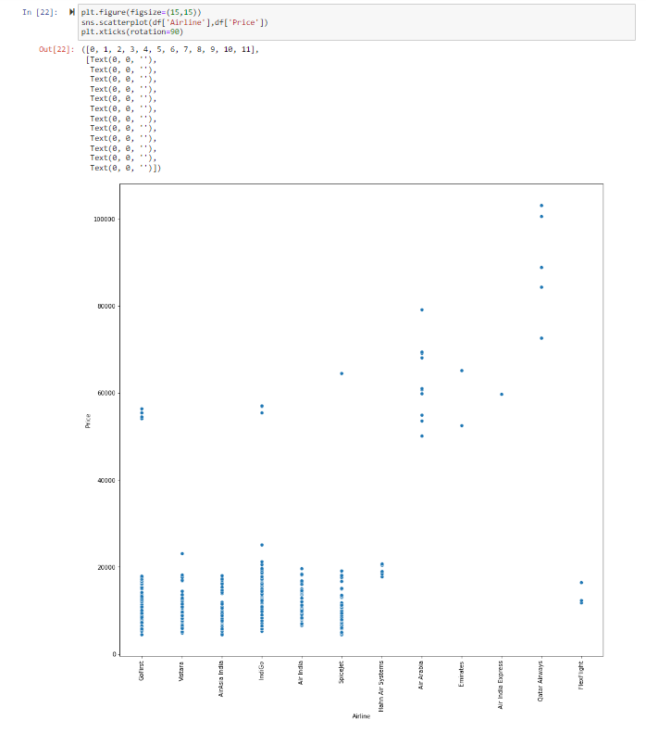
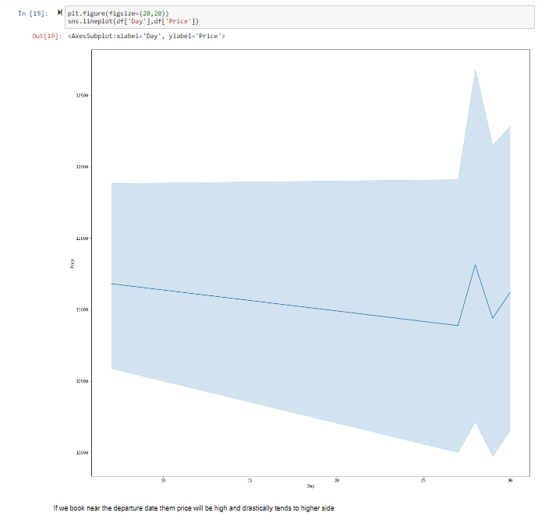

Slide 19
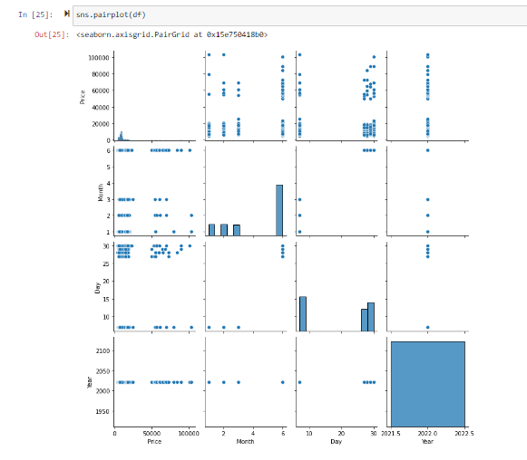
EDA
Multivariate Analysis
Using the pairplot function plot the each column relation with each other to have a better understanding.

Slide 20
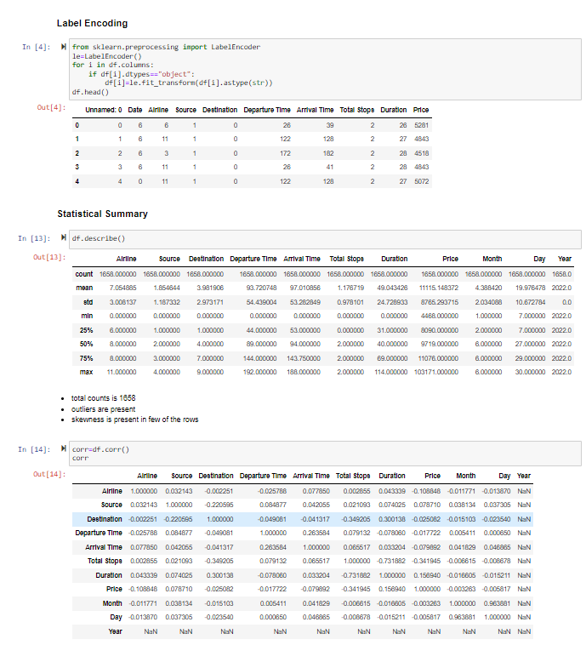
After Doing the EDA, let’s do the next step
Some of the columns have object datatype, we have to convert them in int or float using the Label Encoder
Afterwards, using the describe function we will elaborate the statistical summary of the dataset which contains the count, min, max, standard deviation, mean etc. of every column.
Find the correlation between each column
Plotting the outliers using boxplot
Checking the skewness.
As skewness in the dataset is low we can continue with it
Removing the outliers.

Slide 21
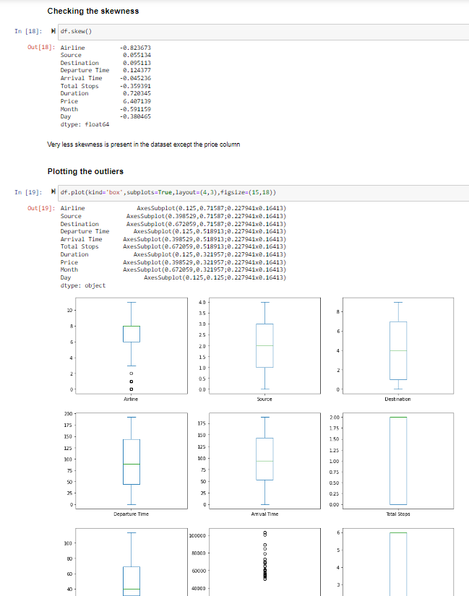

Slide 22
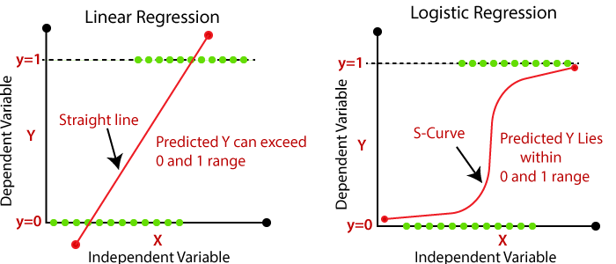
Is this a Regression problem or Classification problem?
By looking at the output i.e. ‘Price’, this is a continuous data not a categorical output so we go for the regression machine learning algorithms to predict the Price.
What does Regression mean?
In Regression, the output is continuous data. In this method, we predict the trends of training data based on the features. The result does not belong to a certain category or class, but it gives a numeric output that is a real number. For example, predicting House Prices is based on certain features like size of the house, location of the house, and no. of floors, etc.

Slide 23


Slide 24
Used Regression Algorithms
Linear Regression
from sklearn.linear_model import LinearRegression
Decision Tree Regressor
from sklearn.tree import DecisionTreeRegressor
Support Vector Regressor
from sklearn.svm import SVR
Kneighbor Regressor
from sklearn.neighbors import KNeighborsRegressor
Random Forest Regressor
from sklearn.ensemble import RandomForestRegressor
Lasso Regularization
from sklearn.linear_model import Lasso
Ridge Regularization
from sklearn.linear_model import Ridge
MODEL | ACCURACY
Linear Regression | 0.3999963569827626
Decision Tree Regressor | 0.7719937778616296
Support Vector Regressor | -0.01887564129226993
Kneighbor Regressor | 0.5116525830272465
Random Forest Regressor | 0.8644094305461366
Lasso | 0.3999359120075674
Ridge | 0.399907003614267

Slide 25
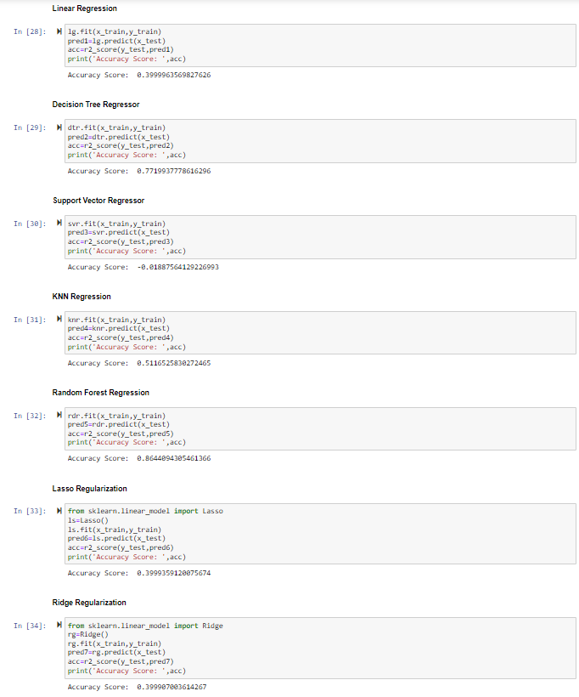

Slide 26
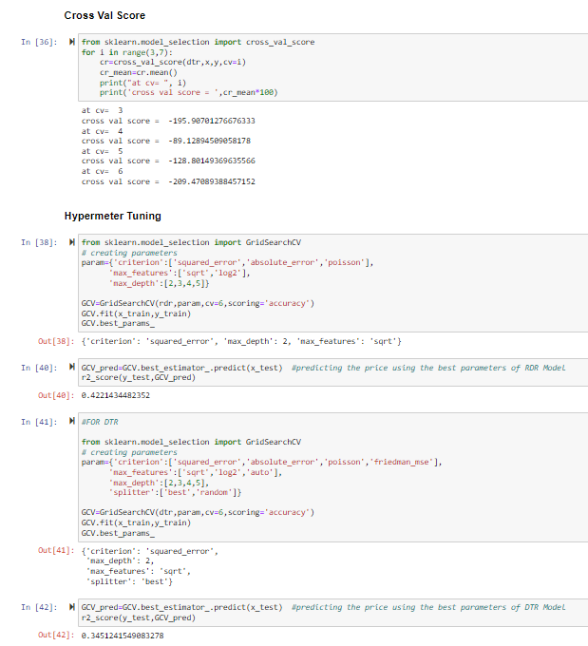
Cross Val Score & Hypermeter Tuning
Finding the cv at which the model runs the best.
Finding the parameters of the model whose accuracy we found the best at which it runs the best using the hypermeter tuning.
We did the cross val score and hyperparameter for Random Forest and Decision Tree Regressors for double check.

Slide 27
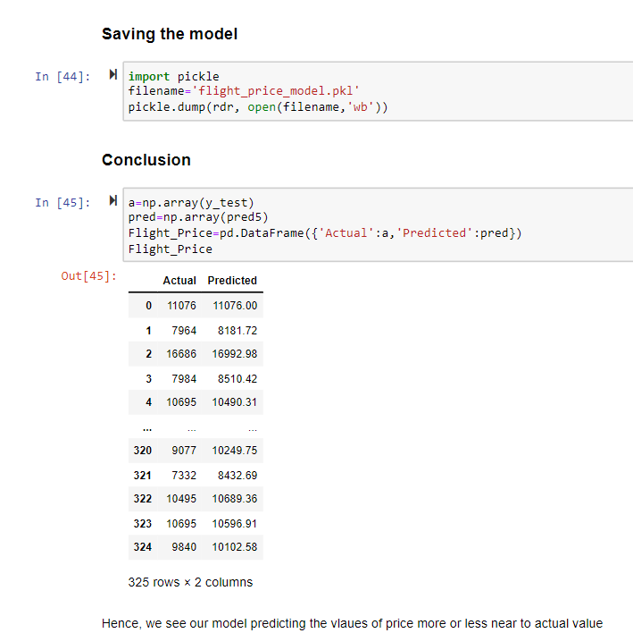
Saving the Model
After doing all the EDA process and find our best regression algorithm we will save that model for future predictions using the pickle algorithm.
We will conclude after comparing the actual & predicted values.

Slide 28


